Slide 1
Predicting the future with R, Visual Studio and Azure Machine Learning
Bhakthi Liyanage
Charlotte Azure User Group
02 August 2017

Slide 2






Bhakthi Liyanage
Bank of America Merrill Lynch
Who am I?
Sr. Application Architect / Data Scientist
17+ years in the IT industry
10+ years in SharePoint
MS in Data Analytics
bhakthil@gmail.com
@bhakthil
https://www.linkedin.com/pub/bhakthi-liyanage/14/15/912
https://github.com/bhakthil

Slide 3
Agenda
Introducing Machine Learning
Introducing Azure Machine Learning
Demo - Azure Machine Learning Studio
Running R on Visual Studio 2015
Demo – Running R Predictive functions on Azure ML Studio
Summary
Q & A

Slide 4
Introducing Machine Learning NOTE: This session does not intended to teach in depth machine learning techniques

Slide 5
What is machine learning?
Academic Definition
Machine learning is a subfield of computer science that evolved from the study of pattern recognition and computational learning theory in artificial intelligence. Machine learning explores the study and construction of algorithms that can learn from and make predictions on data.
Simple Definition
Computing systems that become smarter with learning and experience
Experience = Past data + human input

Slide 6
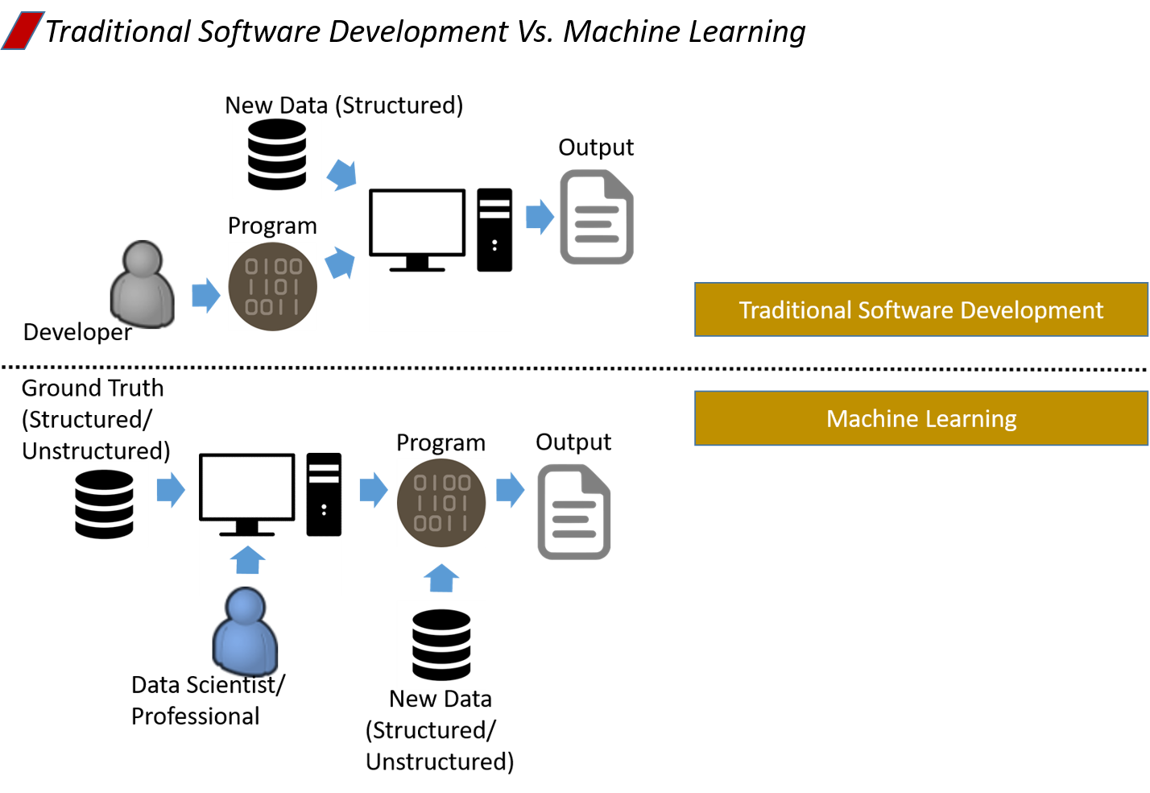

Slide 7












Problem Identification
What problems are we trying to solve?
Anomaly detection
Customer churn
Predictive maintenance
Recommendations system
And more….
Churn analysis
Social network analysis
Recommenda-tion engines
Location-based tracking and services
Predictive maintenance
Vision Analytics
Weather forecasting for business planning
Legal discovery and document archiving
Equipment monitoring
Advertising analysis
Pricing analysis
Fraud detection
Personalized Insurance

Slide 8

Data
Data Consist of
Features (aka input parameters) : The data that is fed in to the model
Identifying which features relevant for the problem
Labels : Historical result of each observation
Training Data
Pairing of features and label
Historical
Validation Data
Used to verify the trained model

Slide 9
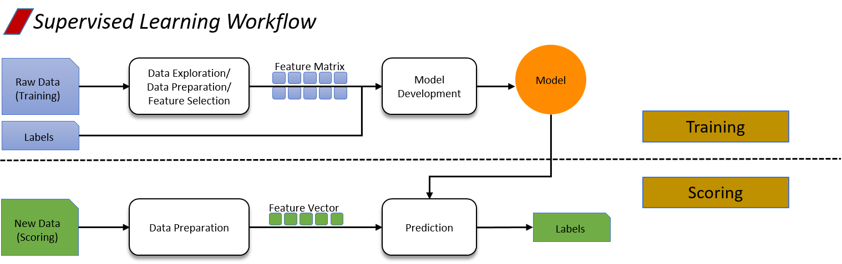
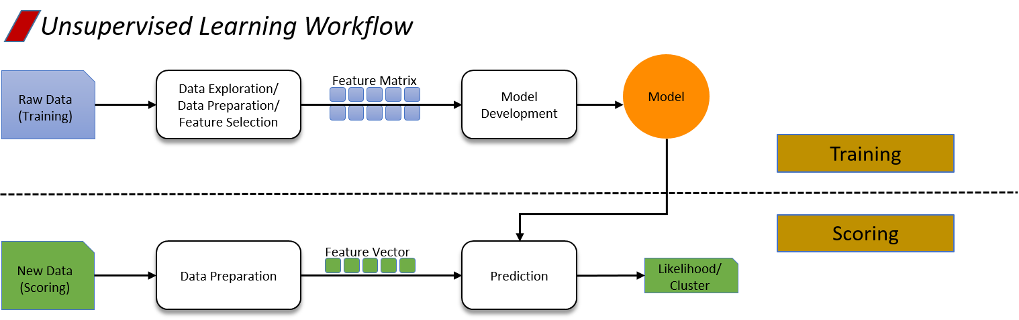
Learning
Supervised
Un-supervised

Slide 10
Machine learning lifecycle
Define Objective
Manage
Collect Data
Integrate
Deploy
Prepare Data
Evaluate Models
Train Models

Slide 11
Introducing Azure Machine Learning

Slide 12
Demo - AML Studio Predicting Car Price

Slide 13
Azure Machine Learning One solution for machine learning
Enables powerful cloud-based predictive analytics
Professionals can easily build, deploy and share advanced analytics solutions
Browser based, Rapid Deployment
Connects seamlessly with other Azure data-related services, including:
Azure HDInsight (Big Data)
Azure SQL Database, and
Virtual Machines
Models are consumed via ML API service

Slide 14


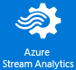

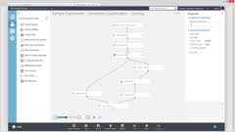





Azure Machine Learning One solution for machine learning
Data
Model Development
Model Deployment
Operationalize
Clients
ML web service end-points
Stream analytics, blob storage,
Azure SQL, HDInsight
Azure ML Studio
Azure ML Services

Slide 15
Demo Predicting the mortality of patients Data set: The ICU data set consists of a sample of 200 subjects who were part of a much larger study on survival of patients following admission to an adult intensive care unit (ICU) Goal: Develop and deploy a regression model to predict the probability of survival to hospital discharge of these patients and to study the risk factors associated with ICU mortality Approach: Develop the model in Visual Studio using R and deploy it in to Azure ML studio

Slide 16
Integrate R with Visual Studio 2015
Requirements
Visual Studio 2015 Update 2 or higher
R Tools for Visual Studio (RTVS)
https://www.visualstudio.com/vs/rtvs/
https://blogs.msdn.microsoft.com/visualstudio/2016/03/22/introducing-r-tools-for-visual-studio-3/
Access to Azure Machine Learning Studio (Azure free subscription is sufficient)

Slide 17
Summary
Machine Learning is a subfield of computer science and statistics that deals with the construction and study of systems that can learn from data.
Azure Machine Learning key attributes:
Fully managed ► No hardware or software to buy
Integrated ► Drag, drop, connect and configure
Best-in-class algorithms ► Proven solutions from Xbox and Bing
R built in ► Use over 400 R packages, or bring your own R or Python code
Deploy in minutes ► Operationalize with a click
Flexible consumption ► Any device capable of consuming REST API
Machine Learning is now approachable to developers

Slide 18
Q & A

